Slide 1
Ch.14 Unsupervised Learning
Part 2
Hans, Stavros

Slide 2
Vector Quantisation
Data compression
How? → Encode data points as indices in a common codebook of prototype vectors
Codebook of vectors → cluster centroids
Lossy compression

Slide 3
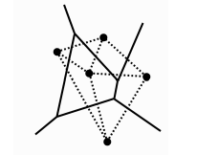
Vector Quantisation (cont.)
2D Example: Voronoi tesselation
Optimal partition of 2D space.
How to choose prototype vectors
Competitive learning (E.g. SOMs)

Slide 4
Self-Organising Feature Map (SOM)
Inspired by sensory signal mapping into cerebral cortex
Mapping retains some order (close representations → close neurons)
Feature mapping with relative order (topology) preservation.
When input and mapping of same dimensionality:
Perfect topology preservation

Slide 5
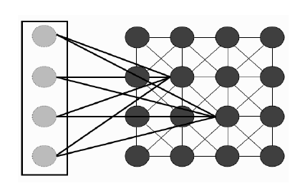
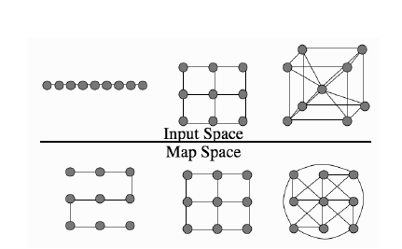
SOM (cont.)
SOM structure
Topology preservation

Slide 6
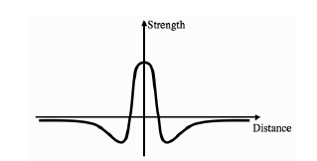
SOM (cont… 2)
Differences with MLPs
Unsupervised
2D (not always)
Lateral connections between neurons
Lateral connections
Within the neighbourhood, close neurons are “pulled closer”, while further are “pushed away”
Not in neighbourhood → do nothing
Mexican Hat

Slide 7



SOM algorithm
For each data point:
Select best matching neuron
Update weight of best matching neuron
Update weight of all other neurons
Reduce learning rate, neighbourhood function.

Slide 8
Neighbourhood Connections
Learning done in 2 phases:
Ordering
Convergence
For weights initialised randomly, initially the map is unordered
Larger initial neighbourhood required, and then reduced.
For weights initialised through PCA, ordering is mostly done, so smaller initial neighbourhood is sufficient.

Slide 9
Neighbourhood Connections (cont.)
Training requires all data available → online learning not possible.
We could ignore this constraint, but could also use networks designed for this (Fritzke’s “Growing Neural Gas” and Marsland’s “Grow When Required” Network)

Slide 10
Self-Organisation
This part may be not intuitive:
Local interactions cause a global ordering
Examples (flock of birds, simulations, etc.)

Slide 11
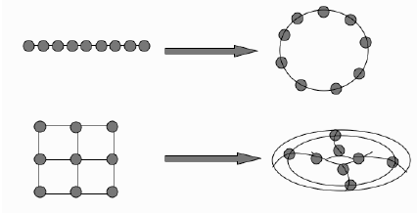
Network Dimensionality and Boundary Conditions
Dimensionality → Should be chosen based on intrinsic input dimensionality (1D or 2D)
In case of not well defined boundaries, more complex boundary conditions necessary

Slide 12
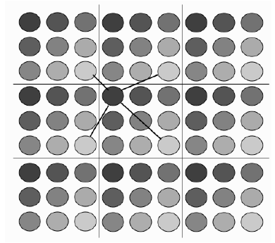
Boundary Conditions
Implementation example (2D)

Slide 13
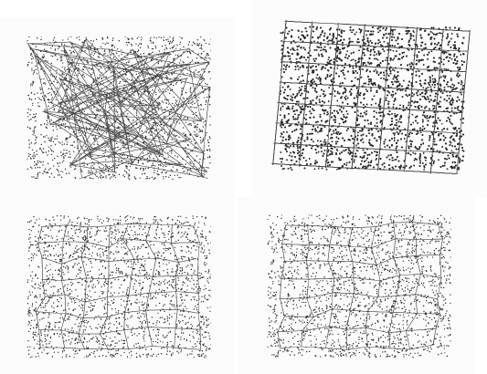
Examples - Applications
Uniform random sampling of 2D data

Slide 14
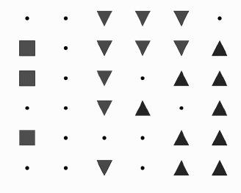
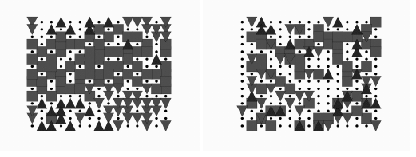
Examples 2
E. coli dataset
Iris dataset

